Slide 1

4) Conjoint and Discrete Choice

Slide 2

Example:
A client in the kitchen appliance industry is interested in obtaining information about a bread maker product. There are several questions about pricing, product optimization, market share, and potential market segments that might exist. How can these questions be addressed?

Slide 3
Overview: Conjoint and Discrete Choice
Fundamental to marketing decision making is an understanding of what customers value with regard to products and services. Conjoint and discrete choice are methodologies used to assess customer value.
Sometimes called trade-off analysis, conjoint/discrete choice reveal customer value through methods that more closely resemble the purchase decision making process than traditional methods that obtain information about product/service components using monadic methods.

Slide 4
Overview: Conjoint and Discrete Choice
Example: In the purchase of a bread maker, how important to you are each of the following (rate using a 0 to 10 scale).
Brand
Capacity
Loaf Shape
Price

Slide 5
Overview: Conjoint and Discrete Choice
In Conjoint/Discrete Choice products/services are usually presented as a bundle of features and prices in such manner that the respondent must :
Rankings or ratings conjoint
Types include
full profile
self explicated*
Choice based conjoint (CBC)/ discrete choice
Choose one or several

Slide 6
Product Example
Breadmaker - features & levels
Brand
Loaf Shape
Price
Oster
Square
$139
Braun
Rectangular
$149
Sears
$159
Panasonic

Slide 7
Overview: Conjoint and Discrete Choice Basic Terms
Features or Attributes
items play an important role in driving choice or preference
Levels of Features or Attributes
specific points for each feature
can be qualitative (brand), or quantitative (price)
Profile
set of specific levels for each feature

Slide 8
Overview: Example Conjoint Respondent Task (full profile conjoint)

Slide 9
Overview: Example Discrete Choice Respondent Task

Slide 10
Overview: Conjoint and Discrete Choice
Using responses from respondent tasks, utility functions can be estimated for respondents
Example of a utility function for the bread maker example.
U = βOster + βBraun + βSears + βPanasonic +
βShape₁ + βShape₂ +
βPrice₁ + βPrice₂ + βPrice₃
Utility of Oster, Rectangular shape, at $139 = βOster + βShape₂ + βPrice₁

Slide 11
Overview: Conjoint and Discrete Choice
Uses of Conjoint/Discrete Choice
New Product Development
-determine features and price for new products
Product Optimization
-revise and reformulate existing products to improve share of preference/choice
Market Segmentation
Price Elasticity
Channel Switching
Cannibalization
Market Share Estimates
Brand Equity

Slide 12
Self-Explicated “Conjoint” and Conjoint Fundamentals
For our bread maker example
Brand Loaf Shape Price
Oster Square $139
Braun Rectangular $149
Sears $159
Panasonic
Recall the basic conjoint utility function
Total utility of a product/service = sum of constituent component utilities (part-worths)
U = βOster + βBraun + βSears + βPanasonic +
βShape₁ + βShape₂ +
βPrice₁ + βPrice₂ + βPrice₃
Utility of Oster, Rectangular shape, at $139 = βOster + βShape₂ + βPrice₁

Slide 13
Self-Explicated “Conjoint” and Conjoint Fundamentals
A basic objective in conjoint analysis is to obtain estimates of the above part-worths.
Recall the basic types of conjoint:
-full profile
-self explicated*

Slide 14
Self-Explicated “Conjoint” and Conjoint Fundamentals
We will start with the self-explicated approach. Some researchers do not use the term self-explicated conjoint since the self-explicated approach does not involve trade-offs of the type in other conjoint methods. However, the self-explicated approach has some advantages :
-Simple cognitive task for respondents
-Ease and speed of data collection (e.g., unlike other methods, can
readily be performed using the telephone).
-Ease of data analysis
-Can handle larger number of attributes
-Inexpensive to collect and analyze data
Perhaps the most noted disadvantage is the lack of similarity to the purchase decision process. However, studies have shown that it can be comparable in performance to other conjoint methods. (e.g., see “A Comparison of Conjoint Measurement with Self-Explicated Approaches,” by H. Sattler and S. Hensel-Borner, in Conjoint Measurement (2000), Springer). See also Netzer, O., Srinivasan, V (2011), “Adaptive Self-Explication of Multiattribute Preferences,” Journal of Marketing Research, vol 48, No.1, p.140-156

Slide 15
Self-Explicated “Conjoint” and Conjoint Fundamentals
Respondent Task
A basic way to administer self-explicated conjoint is to use a two step approach. In the first step preference ratings are obtained for each level of all attributes. Attributes are considered in turn, and for each the most preferred level is assigned one scale endpoint, and the least preferred level the opposite endpoint of the scale.
After all attribute levels have been assigned preference ratings, the second step is to assign importance scores to the attributes. This can be performed by having respondents allocate a fixed number of points among attributes. At times it may be better to assign importance scores by having respondents assign ratings (e.g., 0 to 100) to each attribute based on importance, where one attribute is used as a reference (e.g., most important attribute is determined and assigned a value of 100).
Example: Develop respondent task questions for the bread maker example to perform a self-explicated conjoint.

Slide 16
Self-Explicated “Conjoint” and Conjoint Fundamentals
Estimating Utility
With the self-explicated approach, part-worths are estimated by multiplying the attribute level preference ratings by the corresponding importance scores.
As expressed in the basic conjoint function, utility of a particular product/service profile is estimated by summing the associated part-worth estimates.
Interpreting utilities
Note that utilities are on an interval scale (recall scales of measurement—nominal, ordinal, interval, ratio). For interval data, differences are meaningful but not values in isolation.
In general, importance measures for attributes are obtained from the attribute utility ranges. In self-explicated conjoint, importance measures are obtained explicitly.
Example: For the bread maker application obtain a set of estimated part-worths and interpret the results. What types of business issues could be addressed by this type of analysis?

Slide 17
Reporting Conjoint Results: Descriptives and Conjoint Simulators
Recall our bread maker example utilities for the first respondent. Basic descriptives often consist of line graphs.

Slide 18
Reporting Conjoint Results: Descriptives and Conjoint Simulators
Average Utilities and importance scores are common top line summaries, and are also commonly used in displays. However, need to be careful with interpretations. Below is a chart constructed using mean results from 5 respondents.

Slide 19
Reporting Conjoint Results: Descriptives and Conjoint Simulators
Below is an Excel work sheet used to obtain values for the chart on the previous slide

Slide 20
Additional Reading:
“Managerial Overview of Conjoint Analysis,” by Bryan Orme
https://sawtoothsoftware.com/resources/technical-papers/managerial-overview-of-conjoint-analysis
https://sawtoothsoftware.com/resources/technical-papers/introduction-to-market-simulators-for-conjoint-analysis
“Introduction to Market Simulators for Conjoint Analysis”

Slide 21
Reporting Conjoint Results: Conjoint Market Simulation and Simulators
Conjoint utilities are typically used to simulate preference share in the marketplace. Market simulators automate the simulation task and readily allow users to model preferences and estimate shares. Simulators are commonly used to conduct what-if types of analyses and address marketing issues that include: product optimizations, new product introductions, pricing analyses.
Simulating Choice
Assuming rational consumers and a maximum utility structure, product/service preferences can be predicted based upon comparisons of individual level product/service utility composition.

Slide 22
Reporting Conjoint Results: Conjoint Market Simulation and Simulators
Example:
Recall the part-worths for the first respondent in the bread maker example
To predict respondent preference between a Panasonic, rectangular shape at $149, and a Sears rectangular at $149 we can determine the associated product utilities, and predict that the product with largest utility (maximum utility) would be preferred—Panasonic in this case since:
Panasonic, rectangular, $149 = (-2) + (.5) + (0) = -1.5
Sears, rectangular, $149 = (-2.5) + (.5) + (0) = -2.0

Slide 23
Reporting Conjoint Results: Conjoint Market Simulation and Simulators

Slide 24
Reporting Conjoint Results: Conjoint Market Simulation and Simulators
Share simulator and simulators
Expanding our analysis from one respondent to a sample of respondents, we can predict preferences for each, and hence the corresponding product/service shares.
Conjoint simulations offer a number of advantages:
-Transform utilities into share estimates
-Can reveal cross-elasticity effects between different products
-Readily reveal estimates among different segments
-A priori and latent segments.

Slide 25
Reporting Conjoint Results: Conjoint Market Simulation and Simulators
Share Calculation
Consider 5 respondents for the bread maker example, with their corresponding part-worths
Maximum utility method (first choice) for estimating share:
To estimate shares for any specified market scenario, predict the preference of each individual in the sample using the maximum utility approach. Share is estimated by determining the preference proportions for each product/service alternative.
Calculations are greatly facilitated using spreadsheet programs.

Slide 26
Reporting Conjoint Results: Conjoint Market Simulation and Simulators
From BreadMaker_SelfExplicted_Share.Calculator.xlsx

Slide 27
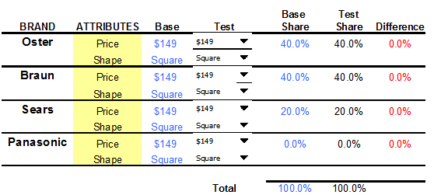
Reporting Conjoint Results: Conjoint Market Simulation and Simulators
From SEC_BMkr.Conj.Simulator_.xlsm

Slide 28
Reporting Conjoint Results: Conjoint Market Simulation and Simulators
Simulator Features
-User-friendly interface
-Base Case comparisons
-Simulators often include side-by-side comparisons of the test scenario results with a base scenario that is often the current market conditions.
-Facilitate “what-if”, product optimization, and sensitivity analyses
Optimization criteria can include share, sales, and contribution if relevant information is available.

Slide 29
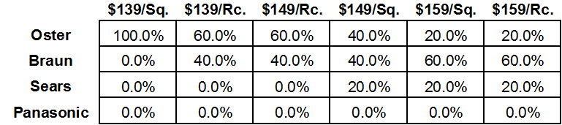
Reporting Conjoint Results: Conjoint Market Simulation and Simulators
Example: Conduct a product optimization analysis for Oster with competition at current market conditions

Slide 30
Reporting Conjoint Results: Conjoint Market Simulation and Simulators
Simulator Features
-Conducting pricing analysis
Example: Investigate Oster price changes with respect to current market conditions

Slide 31
Reporting Conjoint Results: Conjoint Market Simulation and Simulators
Simulator Features
-Segment level analyses are readily made

Slide 32
Reporting Conjoint Results: Conjoint Market Simulation and Simulators
Estimating Actual Market Share with Conjoint Simulators
Conjoint utilities are derived under artificial conditions. It is important to consider market factors such as awareness, distribution, product expectations, and the possibility of important omitted factors.
Adjustments/calibrations are often made in attempts to better model the actual market.

Slide 33
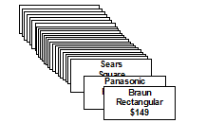
Full Profile Conjoint and Experimental Design
Introduction to full profile conjoint
With the full profile method of conjoint, respondents are presented with a set of entire product/service profiles. Preference ratings or rankings are obtained for each profile and this information is used to determine the part-worths of the attribute levels.
An advantage of this methodology is the realism provided by evaluations of entire product/service profiles.
Example:
Brand Loaf Shape Price
Oster Square $139
Braun Rectangular $149
Sears $159
Panasonic

Slide 34
Introduction to full profile conjoint
For the bread maker example there are 24 different profiles that are possible.
A respondent provided preference ratings for each profile using a scale from 0 (lowest preference) to 100 (highest preference). Results are provided below.

Slide 35
Introduction to full profile conjoint
Ordinary least squares regression (OLS) can be used to obtain the part-worth estimates. Note that effects coding is typically used in conjoint for the attributes. Data is in SPSS file FPC_BdMkr_full.sav

Slide 36
Introduction to full profile conjoint
Yhat = 54.50 + 11.83(Oster) + 8.17(Braun) + 3.83(Sears) + 6.08(Sqr) + 8.50($139) + 3.25($149)
What are the importance measures for brand, shape, and price?

Slide 37
Relative Attribute Importance
In general, importance measures for attributes are obtained from the utility ranges. The general formulation for attribute importances for conjoint is as follows:
Importance of Attribute a =
(part worth range for Attribute a)/ (sum of the part-worth ranges for all attributes)

Slide 38
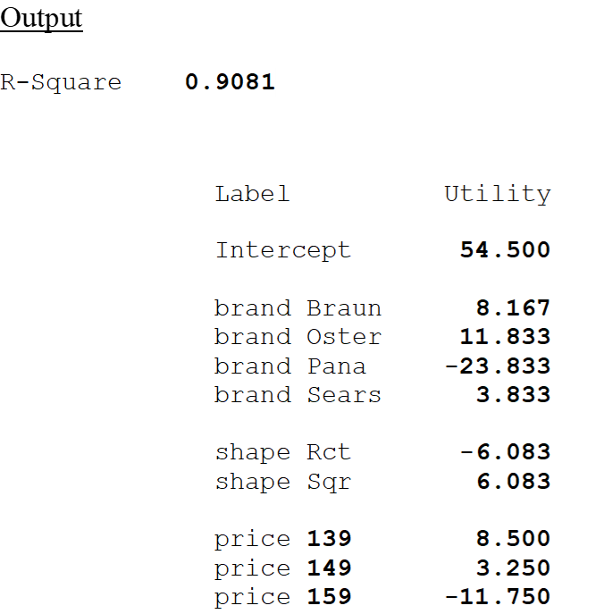
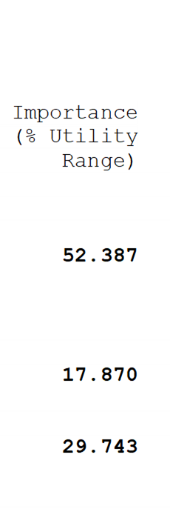
Standard Output from Conjoint Software

Slide 39

Experimental Design for Conjoint
Note that in our example the design considered all possible combinations (called a full factorial design). However, in practice it is typically sufficient to use only a fraction of the total number of combinations (called a frational factorial design) to estimate the needed part worths.
In fact, it is often impractical to employ all possible combinations in a conjoint design. The resulting number of profiles to evaluate may be too many and may include some unrealistic combinations.
Basically, an experimental design for conjoint specifies
-How many profiles the respondent will evaluate, and
-The composition of the profiles
We will consider how to create and evaluate (what’s the difference between a good design and one that’s less than good) experimental designs for conjoint.

Slide 40
Experimental Design for Conjoint
Good designs help produce “Good” (Precise) utility estimates (small standard errors).
In statistical terms we want our designs to be efficient (small standard errors)
Designs that are both balanced and orthogonal are optimal (will produce the most precise utility estimates (smallest standard errors)).
-Balance- A design is balanced if for all factors, the corresponding levels appear with the same frequency.
-Orthogonal- For an orthogonal design, all factors are uncorrelated.
Typically, we can get good designs with less than perfect balance and near orthogonality.

Slide 41
D-Efficiency is an overall measure of design efficiency that ranges from 0 to 100. It is based on the average size of the utility standard errors
100% D-efficient designs are both balanced and orthogonal (for a given sample size, will produce the most precise utility estimates (smallest standard errors).
A design with a D-efficiency value of 0 is so poor, not all utilities can be estimated.
Designs that are 100% efficient are often impractical in practice
–-Too large
Typically, we can get good designs with less than perfect balance and near orthogonality.
When creating or evaluating a conjoint design, it is important to consider the D-efficiency measure (overall measure of design quality), balance (look at attribute level frequencies), and attribute correlations (orthogonality)

Slide 42
Creating and Evaluating Designs
Example: Laptop Computer
Features and Levels
Processor
Speed GHz Price Memory HD
1.2 $ 900 4 GB 250GB
1.6 $1100 8 GB 500GB
2.0 $1300
$1500
$1700
Note this example has
–one 5 level factor,
–one 3 level factor,
–two 2 level factors.
How large is the full factorial?
How many profiles are needed (min. design size, also called the saturated design size)?
How can we create a reasonable design?

Slide 43
Creating and Evaluating Designs
Specialized software can create designs and help in evaluation.
SAS has specialized conjoint design software.
We will use 3 SAS macros to help determine a reasonable design size, create the design, and evaluate the design
%mktruns is the macro to determine reasonable design sizes
%mktex will create the design for us
%mkteval will produce the frequencies and correlations to help evaluate balance and orthogonality

Slide 44
For our laptop computer example (sas file FPC_design_laptop.sas) to help determine some reasonable design sizes we can use the sas macro %mktruns
For this example: %mktruns(5 3 2 2)
The bolded numbers are what we provide for this example (since we have a five level attribute (price), a three level attribute (speed), and two 2 level attributes (Memory and HD)

Slide 46
The SAS macro %mktex will the create design with 20 profiles, and store the design under filename “dsn”
%mkteval will produce the attribute level frequencies and correlations.
Proc print will print the created design.
Again, The bolded information is what we provide to the macro for this example.
%mktex(5 3 2 2, n=20,out=dsn,options=nohistory nodups)
%mkteval(data=dsn)
Proc print data=dsn; run;

Slide 48
And assigning labels produces the following (can paste into Excel and assign labels)

Slide 49
Creating designs containing restrictions:
Suppose the combinations of 2.0GHz and the three lowest prices are not allowed.
How can a design be created with this restriction?
What are the consequences of this restriction?

Slide 50
Could just remove offending cards from our existing design. The resulting D-efficiency = 88%
Another way:
%macro bad;
bad = ((x2 = 3) & (x1 < 4));
%mend;
%mktex(5 3 2 2 ,n=20, restrictions=bad,options=nohistory nodups, out=dsnr)
proc print data=dsnr;run;
%mkteval(data=dsnr)

Slide 53
Added Application 1)
A manufacturer of protein bars is interested in conducting a conjoint analysis to investigate preferences for different product configurations. After some preliminary research, the following attributes and levels will be investigated
Flavor: chocolate peanut butter, apple cinnamon, blueberry yogurt, triple chocolate
Protein: 15 grams, 20 grams, 25 grams, 30 grams
Carbohydrate: 10 grams, 15 grams, 20 grams
Price: $1.50, $2.00, $2.50
a) How large is the full factorial?
b) What is the saturated design size?
c) Create and evaluate a viable full profile design
d) Suppose the $1.50 price should not appear with 30 grams of protein. How would this change your answer to c)?

